Slide 1

RITM1295263 / ACBSD-4524 BiggyAI Solution Design
[Architect: Mohamed Kerbachi
01/06/2026
Internal

Slide 2
Version Control
Version | Date | Author | Description
01.00 | 12/06/2025 | Mohamed Kerbachi

Slide 3
Background and Objective
Background, Objectives & Solution Summary
Background and objectives overview:​
GTS Neptune Team uses BigPanda for IT incident management and launched a POC for BiggyAI, its GenAI-powered service. The goal: validate BiggyAI’s ability to improve ServiceNow workflows by integrating data from ServiceNow, and Teams MIM channels.​
​
Transition to future state:​
BiggyAI can be integrated into production and complies with all approved security patterns, including SSO via EntraID, OAuth 2.0, and IP whitelisting. Real-time ServiceNow connectivity has been implemented through an API Gateway in Aegon’s AWS tenant. Neptune integration remains planned for a future phase.
Executive Sponsor ​
Stefan Simenon​
​
Initiative Sponsor​
Jeremy Kulbartz​
​
Business Unit Sponsor​
[GTS]

Slide 4
Business Case
Impacted Business Units
Problem statement:
The growing volume and complexity of incidents in ServiceNow.
The need for faster, more intelligent incident resolution.
The strategic initiative to adopt AI and automation across IT operations.
Promise of Value:
The POC demonstrated that Biggy AI significantly reduced manual effort, accelerated response times, and improved the accuracy of incident triaging and resolution. These improvements led to better service quality, higher user satisfaction, and enabled more proactive IT operations.
The following Country/Business Unit(s) will be impacted by this Solution Design:
☐ | TA | ☐ | Spain
☐ | UK | ☐ | HR Global
☐ | NL | ☐ | ASIA/TLB
☐ | AAM | ☐ | Corporate Centre
X | GTS / Corporate tech | ☐ | Other (Specify) _________________
☐ |  | X | Global
Enterprise Architecture Classification
X | Core: Technology components that are shared by all BUs across the enterprise​
☐ | Common: Technology components shared by multiple business units within the enterprise
☐ | Distinct: Technology components that are specific to a particular business unit within the enterprise​

Slide 5
Key Business Requirements
Business Requirements ​
Requirement ID ​ | Name ​ | Description ​ | Priority ​
BR-001 ​ | Accelerate Incident Resolution ​ | Reduce mean time to detect (MTTD) and mean time to resolve (MTTR) by surfacing relevant insights quickly. ​ | Must Have ​
BR-002 ​ | Enhance Operational Efficiency ​ | Automating routine duties and optimizing work processes. ​ | Must Have ​
BR-003 ​ | Improve Decision-Making ​ | Enhance choices with data-backed insights presented in a user-friendly format. ​ | Must Have ​
Notes:
Summary of the key business requirements for the solution

Slide 6
Key Functional Requirements
Functional Requirements ​
Requirement ID ​ | Name ​ | Description ​ | Priority ​
FR-001 ​ | Natural Language Query Interface ​ | Allow users to ask questions in Teams and receive relevant responses. ​ | Must Have ​
FR-002 ​ | Incident Enrichment​ | Merge observability data, historical context, and insights to enhance awareness. ​ | Must Have ​
FR-003 ​ | Automated Action Plans ​ | Trigger preset workflows depending on the nature and severity of incidents. ​ | Must Have ​
Notes:
Summary of the key functional requirements for the solution

Slide 7
Key Non-functional Requirements
Describe the key nonfunctional requirements in scope for the solution design.
Nonfunctional Requirements ​
Requirement ID ​ | Name ​ | Description ​ | Priority ​
NFR-001 ​ | Performance ​ | Guarantee near-real time interactions and minimal delays for users. ​ | Must Have ​
NFR-002 | Performance | Queries from BigPanda and BiggyAI to ServiceNow must not degrade its performance or affect system stability. | Must Have
NFR-003 ​ | Scalability ​ | Designed to manage a large volume of events daily while maintaining consistent performance. ​ | Must Have ​
NFR-004 ​ | Reliability and Availability ​ | Ensure a consistently dependable system. Resilient to failures across all operational areas. ​ | Must Have ​
NFR-005 ​ | Security and compliance ​ | Protect data with robust access controls, encryption techniques, and through audit trails. ​ | Must Have ​
NFR-006 ​ | Data Accuracy | Must have current state of ServiceNow data to within less than 5 minutes to ensure AI responses are accurate to current state. ​ | Must have ​
NFR-006 ​ | Vendor Maintainability ​ | The vendor assumes responsibility for all platform updates, fixes and infrastructure management. ​ | Must Have ​
NFR-007 ​ | Usability ​ | Deliver user-friendly interfaces with clear, easy understandable outputs. | Should Have ​
Notes:
Summary of the key nonfunctional requirements for the solution

Slide 8
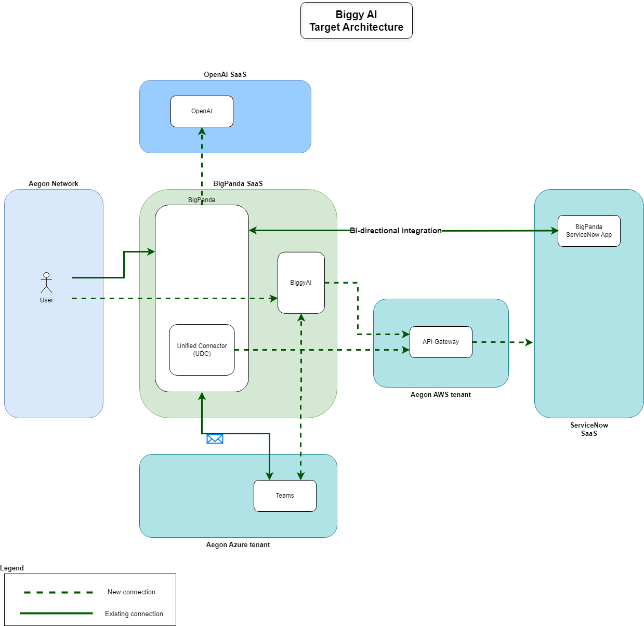
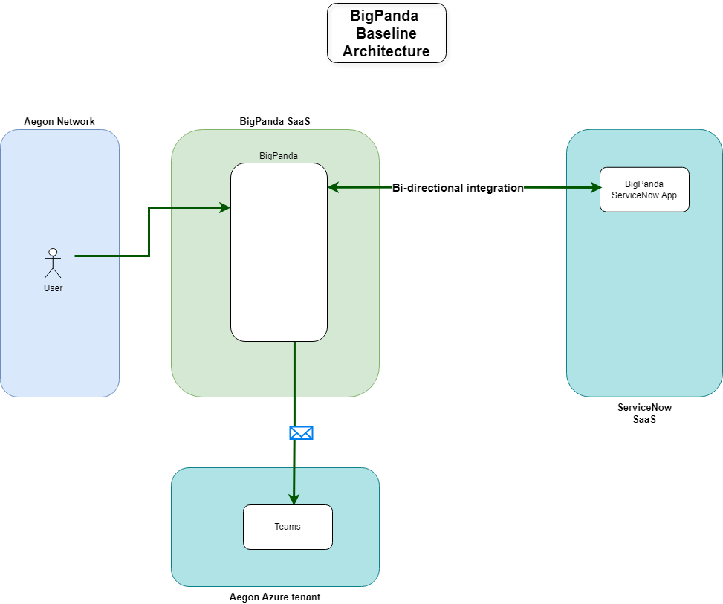
Baseline Technology Architecture
Target Technology Architecture

Slide 9
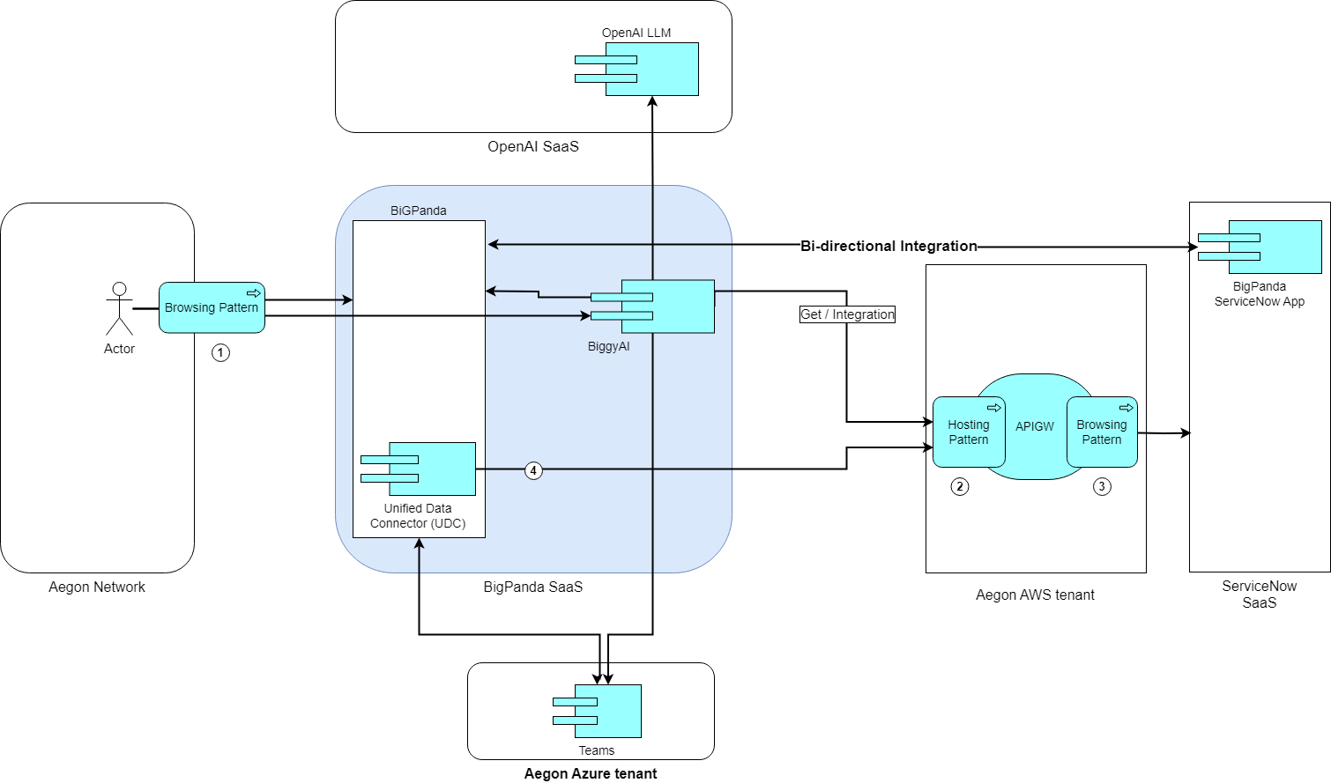
Integration Architecture
Components/Patterns Used |  | Link
1 | Browsing Pattern | GTS APIGW - Project Solution Design Document.docx
2 | Hosting Pattern | GTS APIGW - Project Solution Design Document.docx
3 | Browsing Pattern | GTS APIGW - Project Solution Design Document.docx

Slide 10
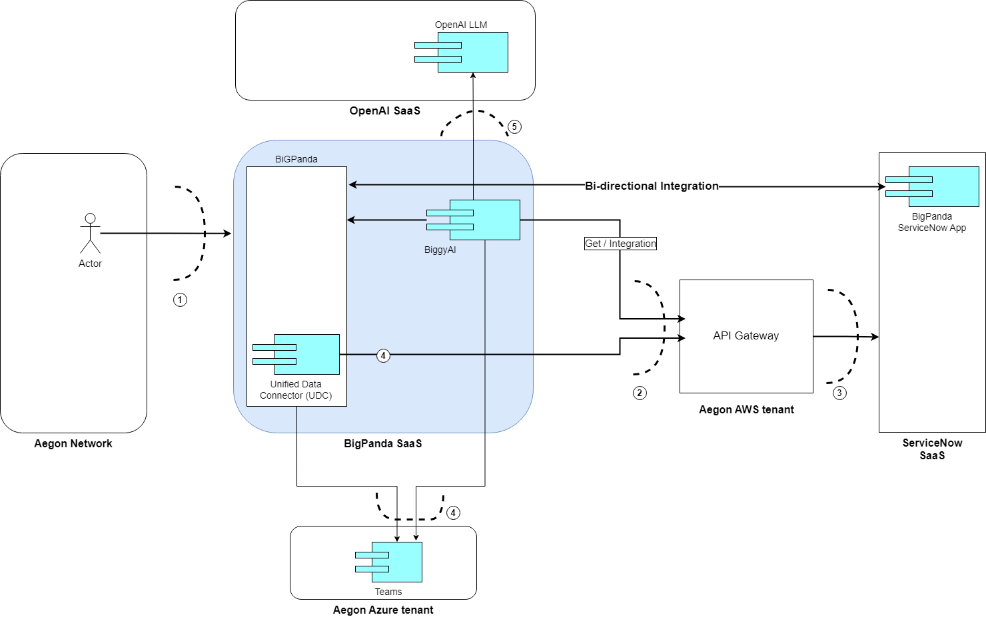
Security Boundaries
Security Boundary Reference | Existing Pattern? | Description
1 | Browsing Pattern | Corporate Firewall.
2 | Hosting Pattern | Corporate Firewall + LB. APIs calls accepted only from whitelisted BigPanda’s IPs.
3 | Browsing Pattern | Corporate Firewall.
4 |  | Access to Teams in Aegon’s Azure tenant, authentication with EntraID
5 |  | BiggyAI access to LLMs hosted in BigPanda Azure tenant. All connectivity and management of this integration are handled exclusively by BigPanda.

Slide 11
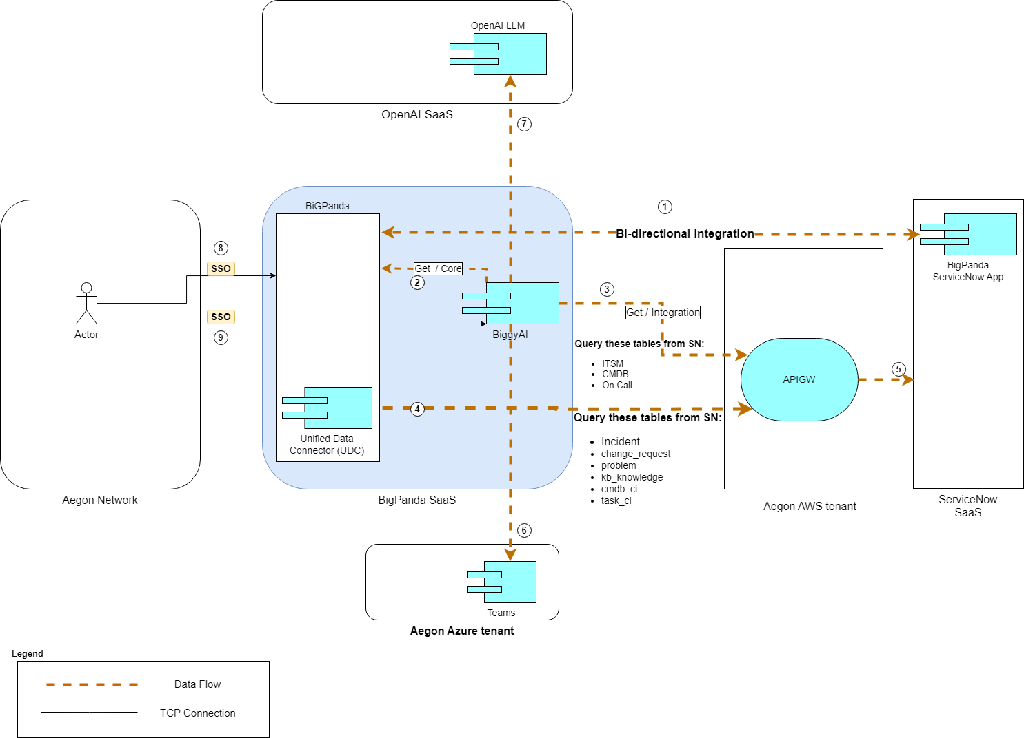
Data Flow
Data Privacy Impact Assessment:​
[DPIA #12351]
Data Classification
Data Classification |  | Data Legal and Regulatory Classification
☐ | Strictly Confidential | ☐ | Financial Information
☐ | Confidential | X | Personal Identifiable Information
X | Internal | ☐ | Protected Health Information
☐ | Public | ☐ | Payment Card Information
☐ | No Data Shared | ☐ | No Personal Data Shared
Data Flow Reference |  | Description
1 | BigPanda connection to ServiceNiw | Existing connection from BigPanda to ServiceNow (RITM0051519-ACBSD-2049- BigPanda Event Management Solution.docx).
2 | Biggy AI query to BigPanda | Internal connection to BigPanda network.
3 | BiggyAI query ServiceNow | BiggyAI queries to ServiceNow for data that has not been received yet after a user question. Get API call using Oauth v2 through Aegon’s API gateway / SSL encryption
4 | BiggyAI query ServiceNow | BigPanda Unified Data Connector (UDC) trickle queries to ServiceNow Get API call using Oauth v2 through Aegon’s API gateway / SSL encryption

Slide 12
Technology Components & Architecture Impacts
Technology Risk Assessment:
[26-BigPanda GenAI Biggy service -Production]
Technology Component Type​ | Technology Component Name​ | CMDB ID​ | Architecture Impact​ | Tech Lifecycle Strategy ​ | Risk Rating​
Business Application​ | ServiceNow​ | CI002457504​ | Reuse​ | Buy​ | High​
​ | Neptune​ | CI017529562 ​ | Reuse​ ​ | Buy​ | High ​
SaaS​ | Teams​ | CI018550166​ | Reuse​ ​ | Buy​ | Low​
SaaS​ | BiggyAI (BIGPANDA AI INCIDENT ASSISTANT)​ | APM0006366​ | New​ | Buy​ | Low​

Slide 13
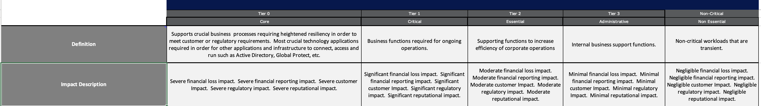
Operational Resiliency Targets
The solution is designed for the following GTS resiliency target level:
The BiggyAI application should be classified as Tier 2, as it assists the operations team in reducing diagnostic time and generating incident reports. While its unavailability would decrease efficiency, teams can continue to operate without it.

Slide 14
Waivers and/or Exceptions
Architecture Alignment to Standards Score: <Enter Score>
Risk Acceptances
# | Acceptance Title | Exception Description | Link to Risk Exception Acceptance
1
2
3
4
5
6
7
No Waiver
No Exception
Risk Remediations
# | Remediation Title | Exception Description | Link to Risk Remediation Acceptance
1
2
3
4
5
6
7
Notes Regarding Exceptions to Standards or Additional Concerns
Prior to an item being added to the ARB agenda for Solution Design – Final ARB, approval for risk acceptance or risk remediation must be obtained, not merely logged. Technology owner for the initiative is responsible for obtaining risk acceptance or risk mediation approvals.

Slide 15

Questions?

Slide 16
End of presentation

